Slide 1








Slide 2

Prediction of songs a user listens to … By using Recommendation systems
Million Songs Dataset Challenge !!
Sandhya Maddula
Shivani Khandelwal
Mayank Sharma
Chandan Kumar
Harsh Shah

Slide 3



About the dataset:
The core of this data set, is the feature analysis and metadata for one million songs, provided by The Echo Nest.
Million Song Dataset aims to address three separate questions –
Recommending songs to a user based on his play history,
Visualizing trends in music across the years and
Predicting the genre of an unknown song based on its lyrics.
Recommender system:

Slide 4
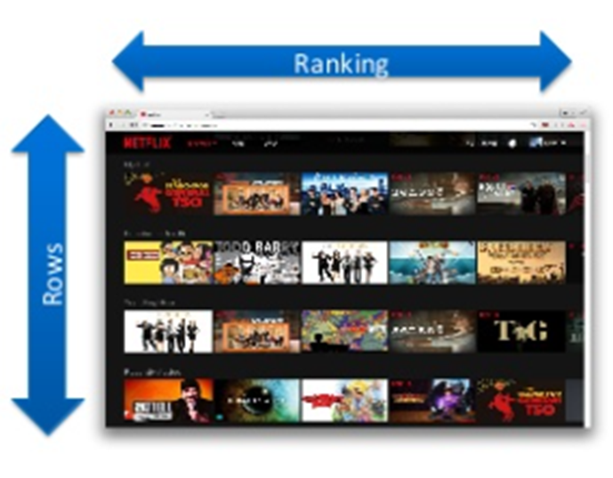
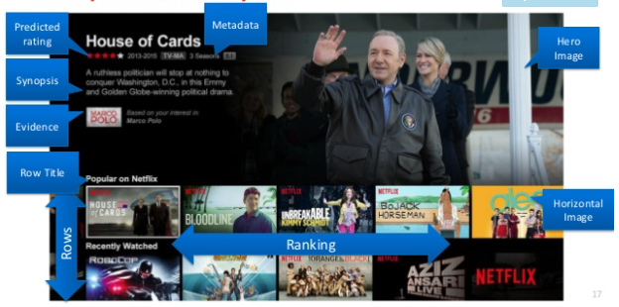
What do Recommender System actually do :
Predict how much you may like a certain product.
Compose a list of N items for you.
Compose a list of N best users for a certain product.
Explain to you why these items are recommended .
Adjust the prediction and recommendation based on your feedback and
other people.
User Data
Recommender
Function
Predicted User
Rating
New Product
Everything is a recommendation !!!

Slide 5
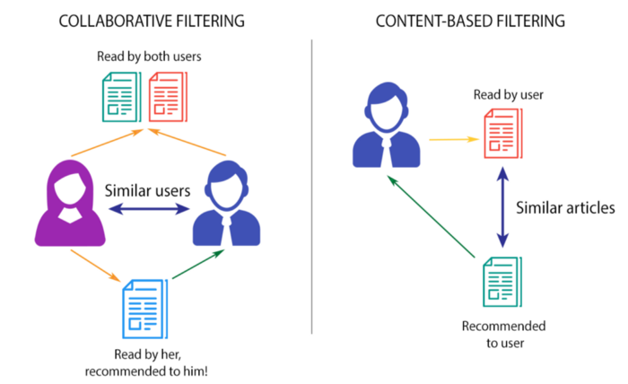
Different types of Recommender system:
Recommender Systems
Collaborative filtering
Model based
Memory based
Content Based Filtering

Slide 6
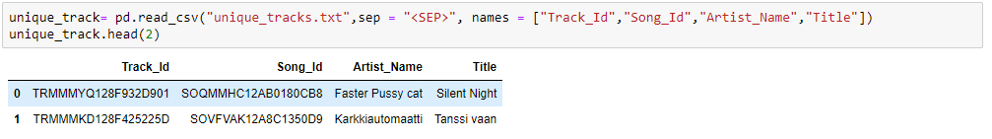
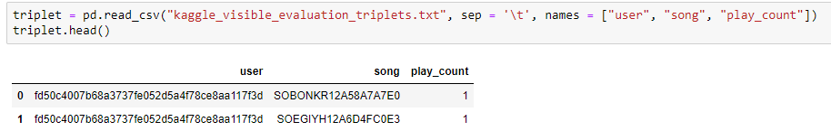
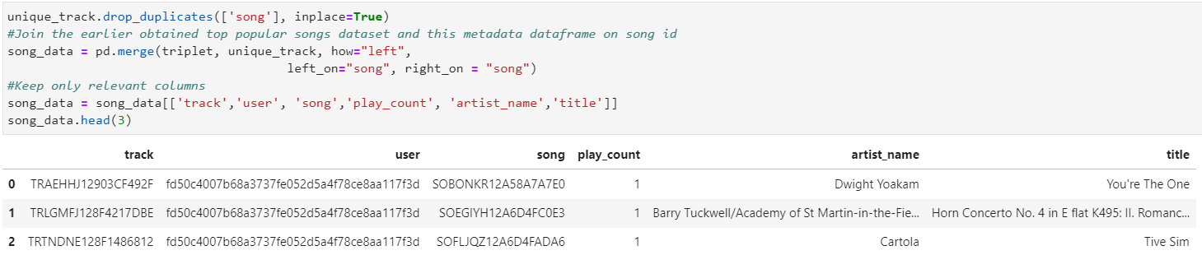
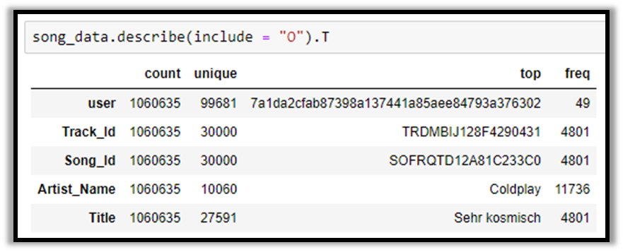
Working on the dataset:
In unique_track, we have 163206 unique
song id's, 29361 unique artists and
137627 unique song names.
In triplet, we have 110000 unique users,
163206 unique songs and 299 play_count values.
Now, the shape of the merged dataset will be
1450933 rows and 6 columns.
Statistical Description of variables:

Slide 7
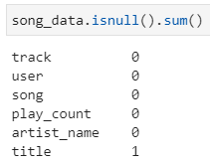
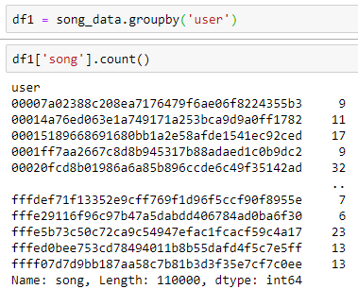
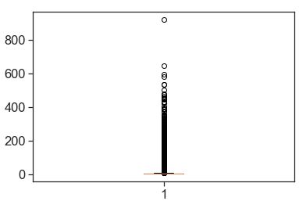
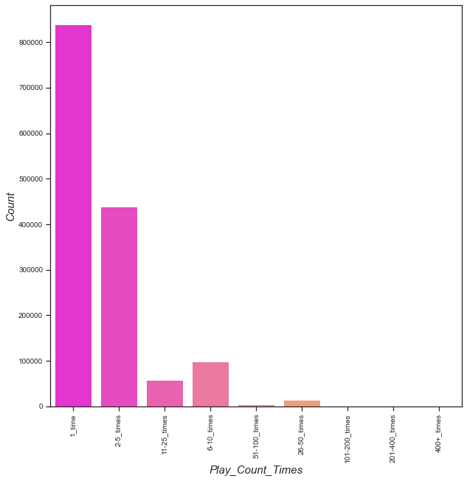
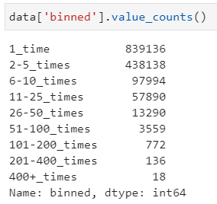
EDA on the dataset:
Play count:
Mean 3.18715074
Median 1.0
Minimum value 1
Maximum value 923
We impute missing value
with mode as title is a
Categorical feature.
In play_count, we can see many outliers because there are only few users who listen to single song many times. Boxplot helps to identify the outliers. And it also tells the mean, median, IQR.
Most of the users listen any song 1 time or 2-5 times. There
are very less users who listen any song more than 100 times.

Slide 8
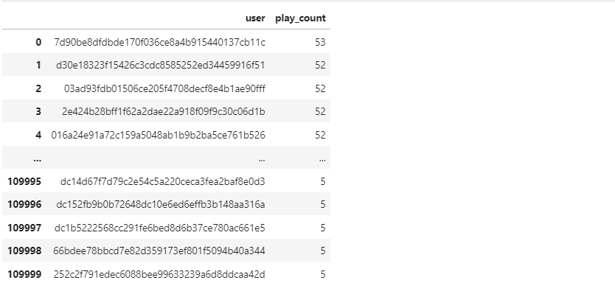
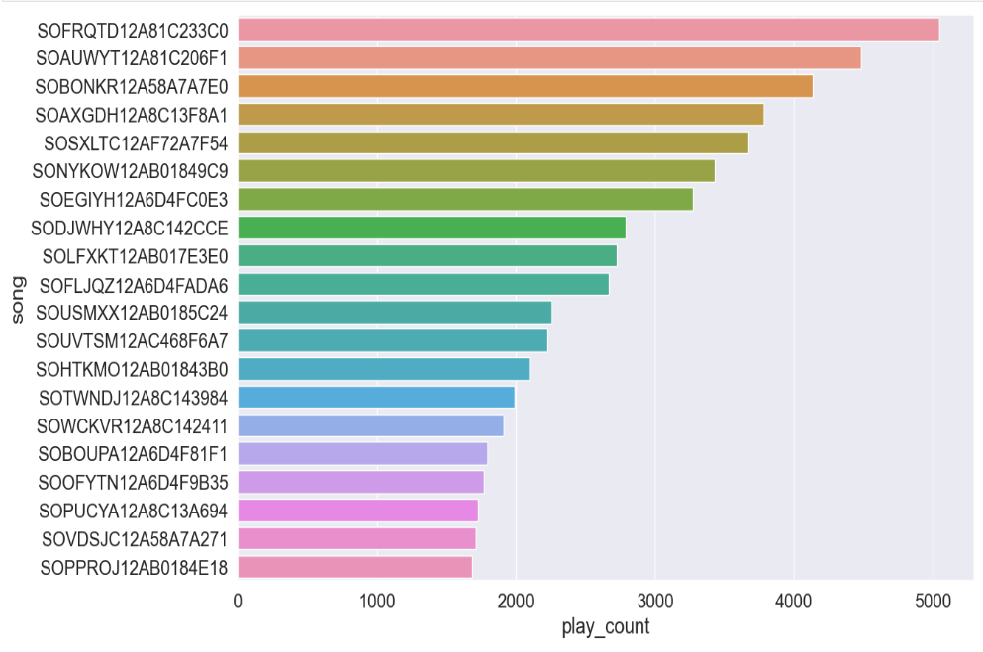
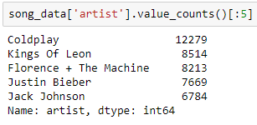
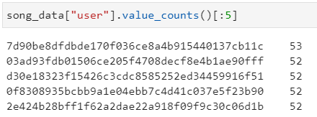
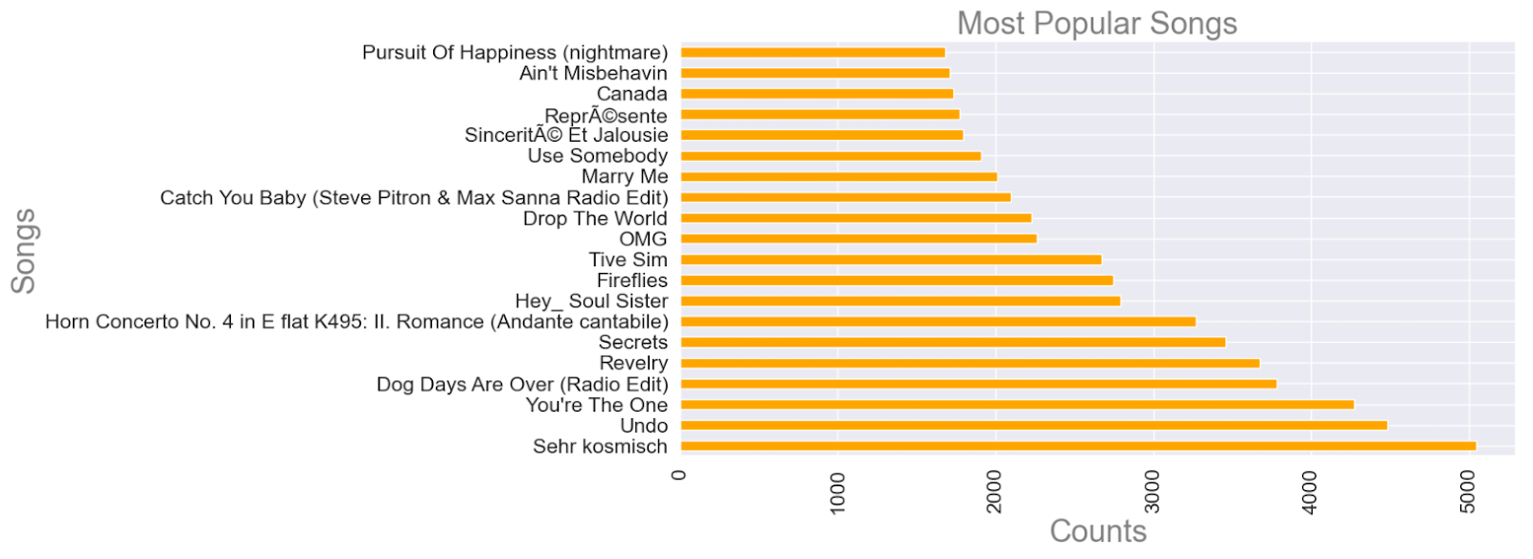
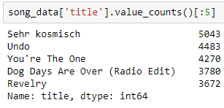
Analysis of Songs:
The Top 5:
Time user listens to a song is analyzed
- Bivariate analysis b/w user & play-count
Most Popular – Top 20 Songs

Slide 9
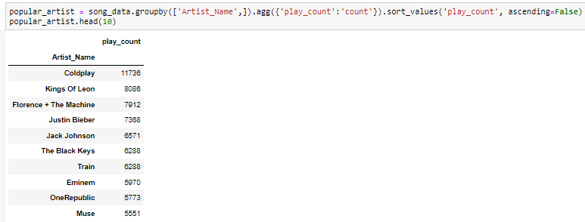
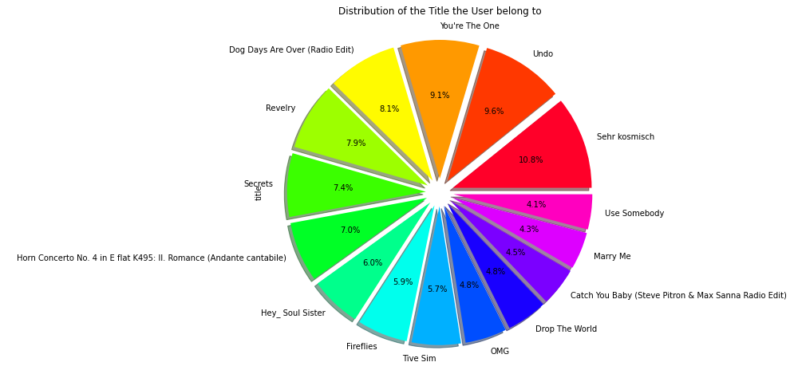
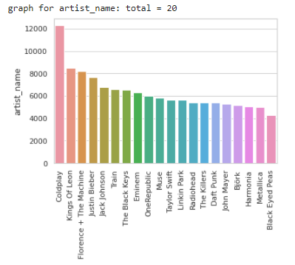




Analysis of Artists:
The more times we listen a song .. The more it becomes famous.. Hence the artists !!
Popular artists can be picked as:
Top 20 songs share distribution in %

Slide 10
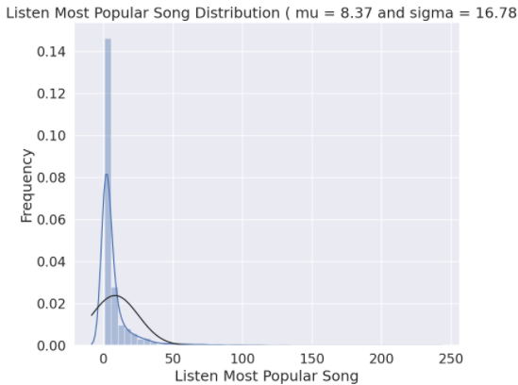
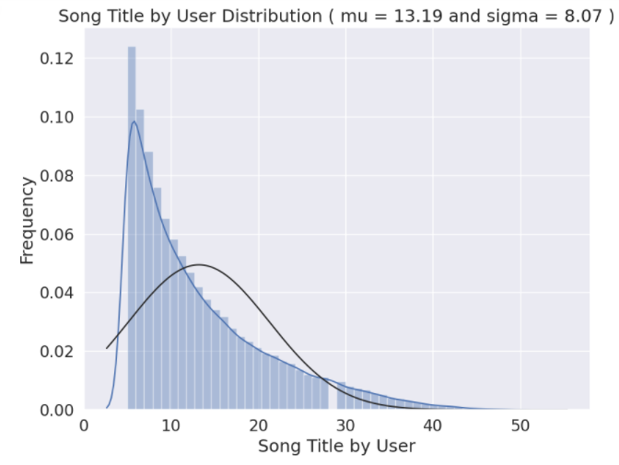
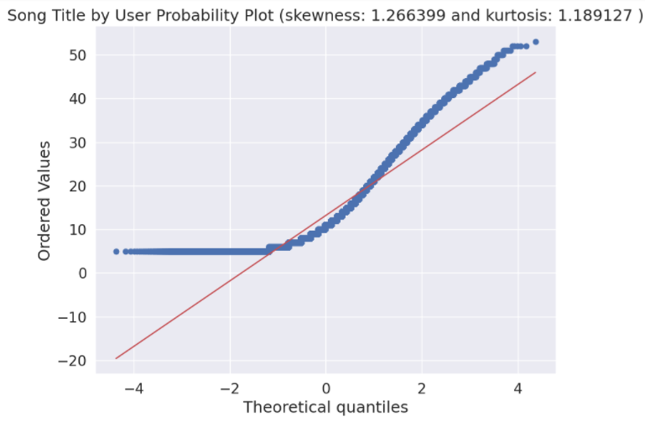
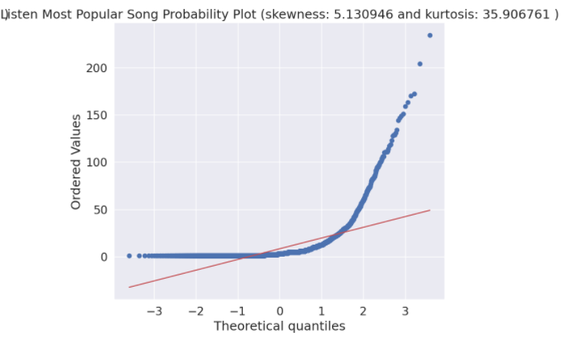
Q-Q Plots:
Skewed, has a peak on the left and a long tail to the right. It deviates from normal distribution and is positively biased.. As we expect, less than a hundred listen a good number of different songs, but enough to raise the average to above 10.
Does not align with the diagonal red line which represent normal distribution. The form of its distribution confirm that is a skewed right.

Slide 11
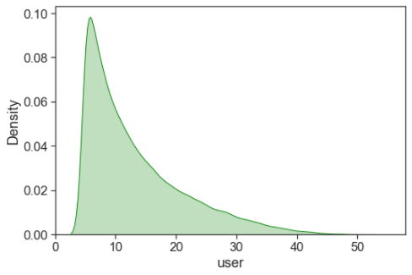
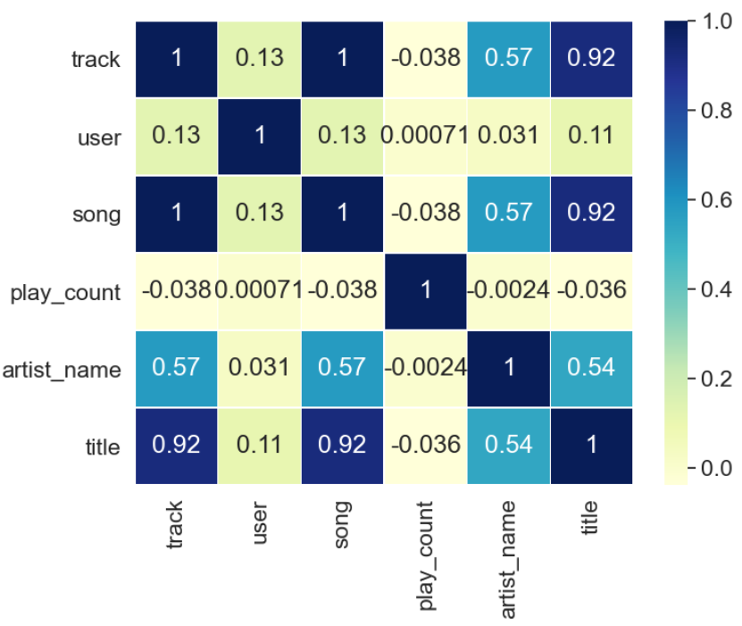
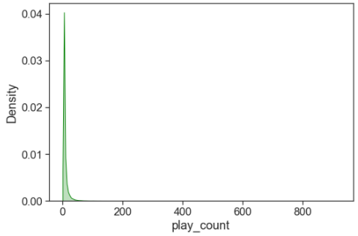
Heat map & KDE plots:
User column is positively skewed and many users listen songs and as the play_count values increases it's frequency decreases.

Slide 12


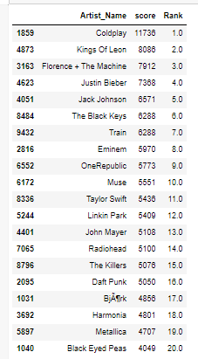
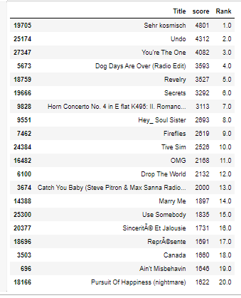
Popularity-Based Recommendation System
Create a Popularity Recommendation model.
Get a count of user id’s for each unique song as a recommendation score
Sort the songs based on score & rank them to get Top recommendations
Similarly, Top Artists
Merits:
No use of historical data
No Cold Start problem
Demerit:
Would recommend same
set of products

Slide 13
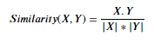
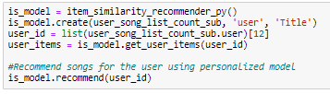
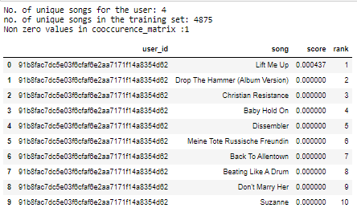
Content -Based Recommendation System
Item Based:
Split the data into training & test data in 70:30 ratio
Create an Item similarity recommender system
Get unique songs corresponding to given user & vice versa
Construct a co-occurrence matrix to make recommendations
Cosine Similarity
Jaccard Similarity
Merits:
Does not depend on user data
No Cold Start problem
Demerit:
Items should be in good volume
Features should be available to compute the similarity.

Slide 14
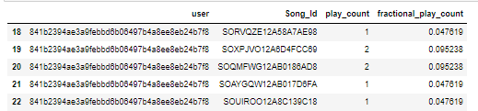
Collaborative Filtering -Based Recommendation System
SVD Algorithm:
We compute this by using SVD Algorithm
The first thing that we notice is that we have no concept of "rating" in our data. All we have are the play counts of various songs. This is a well known problem in the case of recommendation engines and is called the implicit feedback problem.
There are many ways to solve this problem but we will look at a very simple and intuitive solution. We will replace the play count with a fractional play count. The logic being that this will measure the strength of "likeness" for a song in the range of [0,1].

Slide 15
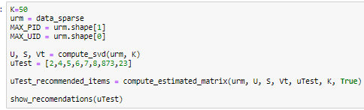
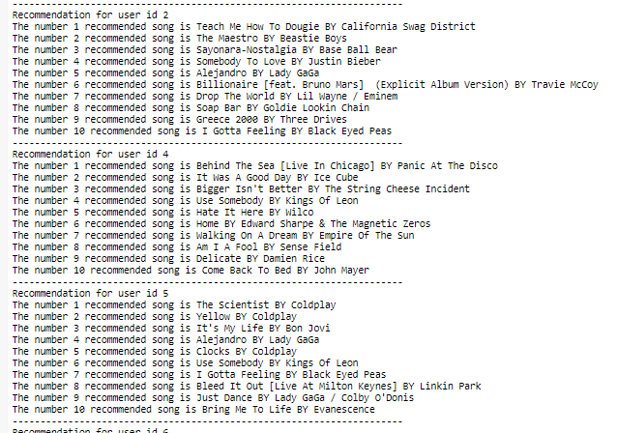
Collaborative Filtering -Based Recommendation System
The next transformation of data that is required is to convert our data frame into a numpy matrix in the format of utility matrix.
We will convert our data frame into a sparse matrix, as we will have a lot of missing values and sparse matrices are suitable for representation of such a matrix.
Since we won't be able to transform our song IDs and user IDs into a numpy matrix, we will convert these indices into numerical indices. Then we will use these transformed indices to create our sparse numpy matrix.
.

Slide 16
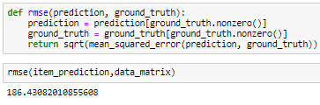
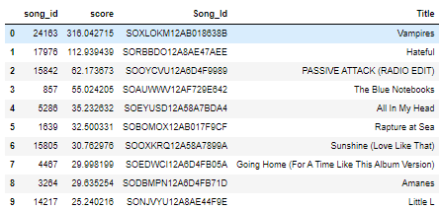
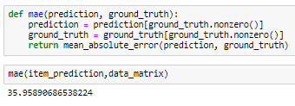
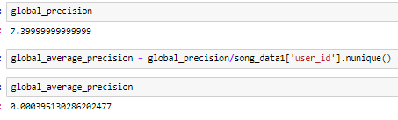
Collaborative Filtering -Based Recommendation System
Pairwise Distances:
Encode the songs
Split the data into train &test data
Create empty data matrix: user*song
Pairwise distance with cosine metric
Dot product of Data Matrix with User similarity
Evaluation:
RMSE
MAE
Merits:
Smart & not restricted to
taste of the user.
More efficient when large
volume of information
about users & items.
Demerits:
Problems arise like user &
rating matrix to be sparse
becoming challenging to
find users rated same item
Precision@K

Slide 17

THANK YOU

